Slide 1
Self Driving Car system
Submitted by: Nishikanta Parida
Regd no: 2124100015
Guided by: Dr. Debasis Gountia

Slide 2
CONTENT
Introduction
Problem Statement
Objective
Proposed Solution
Methodology
Code and Structure
Accuracy Matrics
Results

Slide 3
INTRODUCTION
A self-driving car (an autonomous car / driverless car) is a vehicle that uses a combination of sensors, cameras , and Machine Learning to drive itself without a human operator.
In this SELF DRIVING CAR system, we used a CNN model to identify the road features from the image/frame and then predict the steering angel from that.

Slide 4
PROBLEM STATEMENT
SELF DRIVING CAR system is a key technique in most of road transport related applications and is an active research topic in the AI and image processing domain.
But due to the varying characteristics of the road , weather conditions, road signs ,pedestrian Behaviour, and road safety rules further research is still needed in this area to develop a safe fully autonomous car .

Slide 5
OBJECTIVE
The objective of this project is to build an efficient self driving car - system which can drive a car in different challenging conditions by adjusting car’s control system autonomously.

Slide 6
PURPOSED SOLUTION
Our proposed solution is to implement the SELF DRIVING CAR system by using a convolutional neural network (CNN) model to map raw pixels from a single front-facing camera directly to steering commands.
And models to recognise traffic light, other vehicles as well as pedestrian.

Slide 7
Methodology
Creating Training Dataset
Data set Pre-Processing
Training Model
Recognising Output
Performance Evaluation

Slide 8
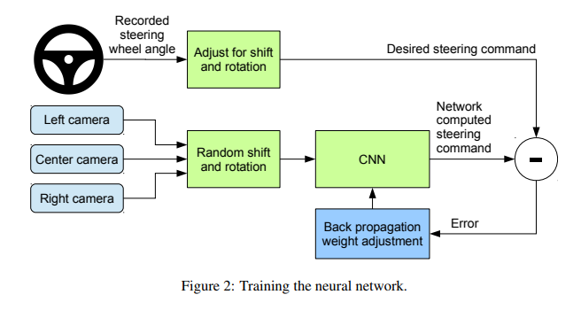
3
2
4
6
1
5

Slide 9
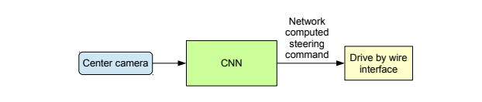

Slide 10
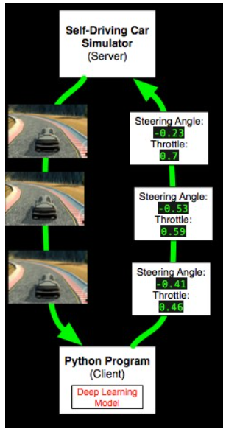

Slide 11
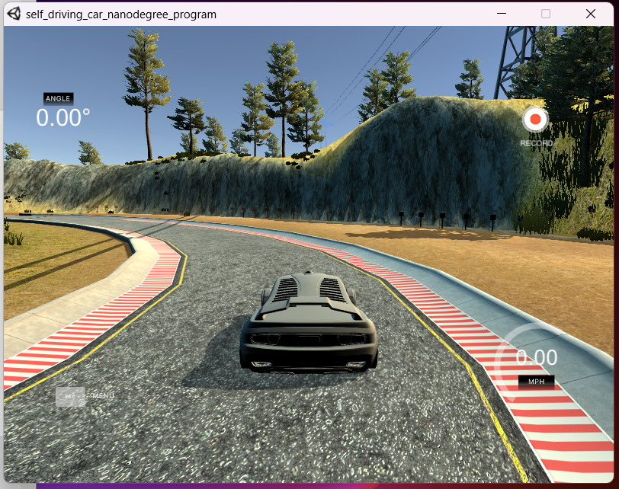
udacity/self-driving-car-sim

Slide 12
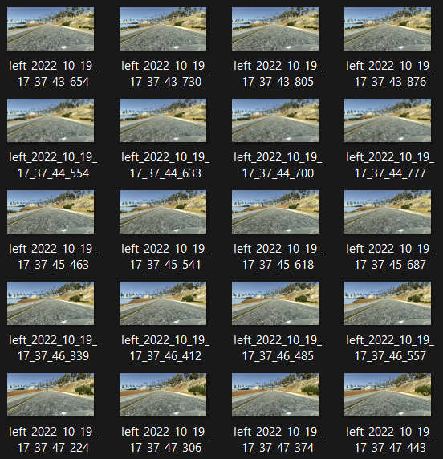
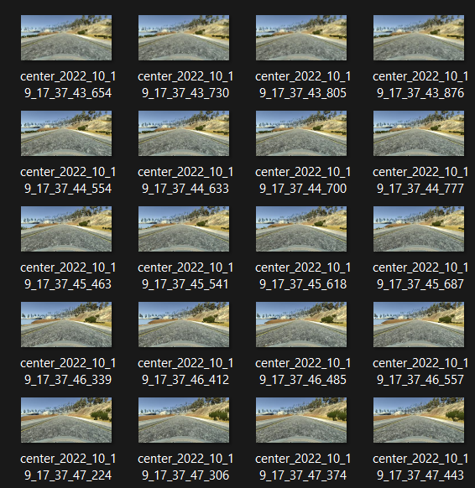
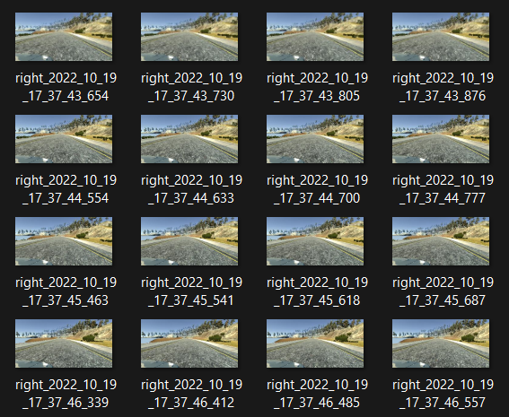
left
center
right

Slide 13
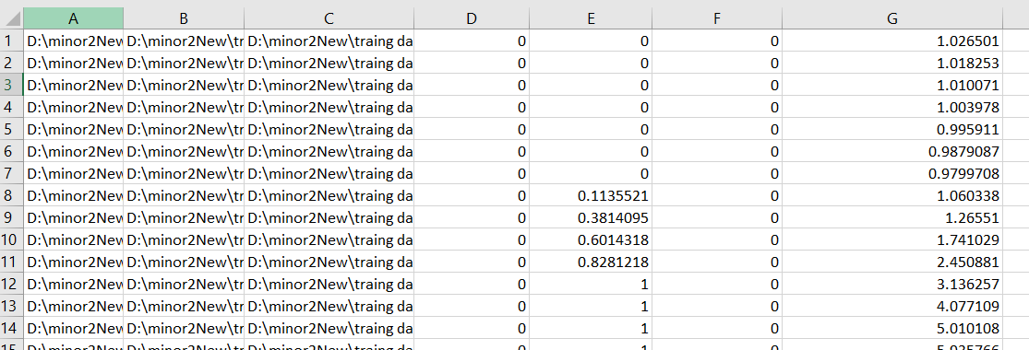

Slide 14
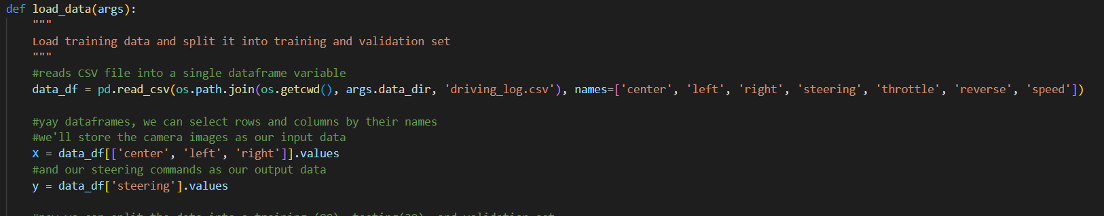

Slide 15
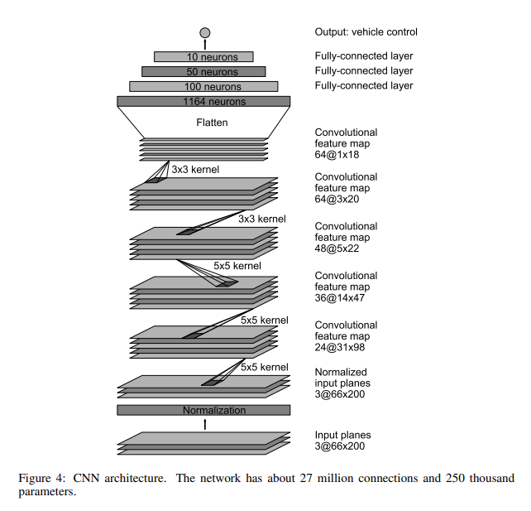
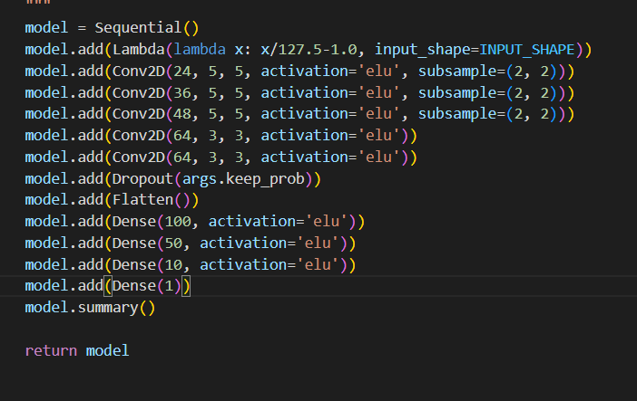
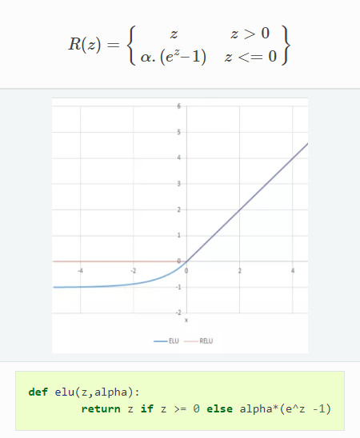

Slide 16
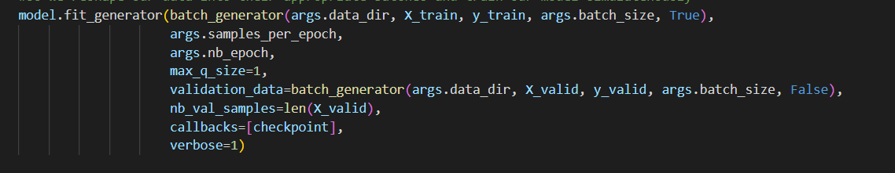

Slide 17
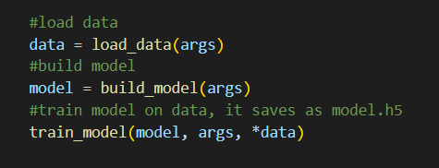
ACCURACY METRICS :
Mean squared error: 0.2

Slide 18
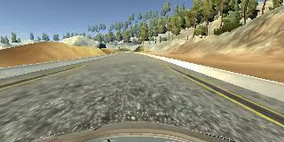
Before
After

Slide 19
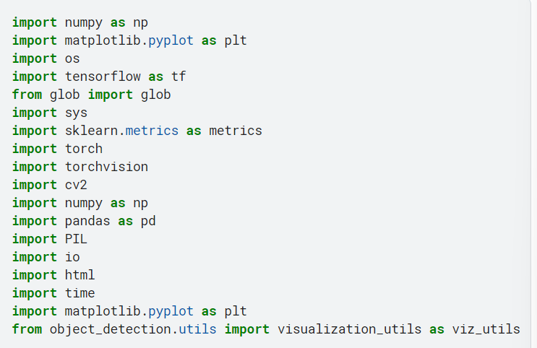
Traffic Light Detection and Classification

Slide 20
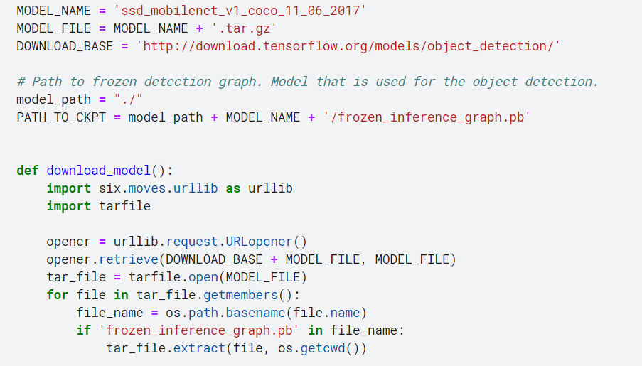

Slide 21
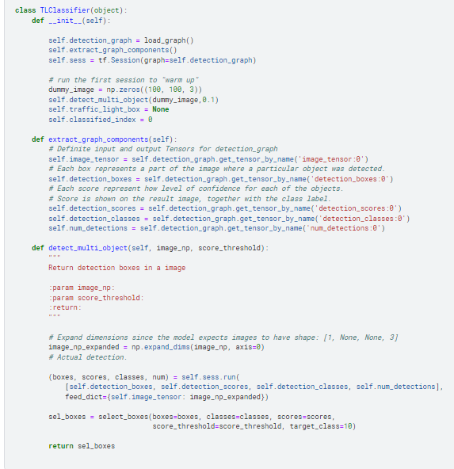

Slide 22
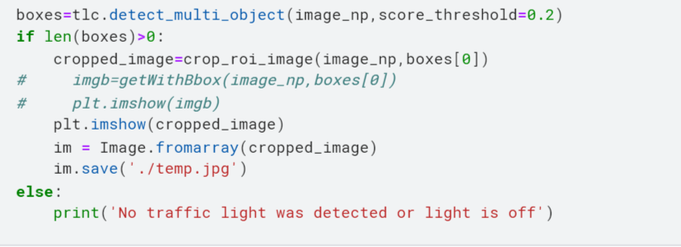

Slide 23
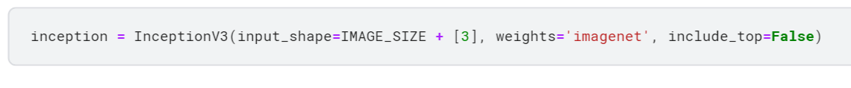
CLASSIFICATION

Slide 24
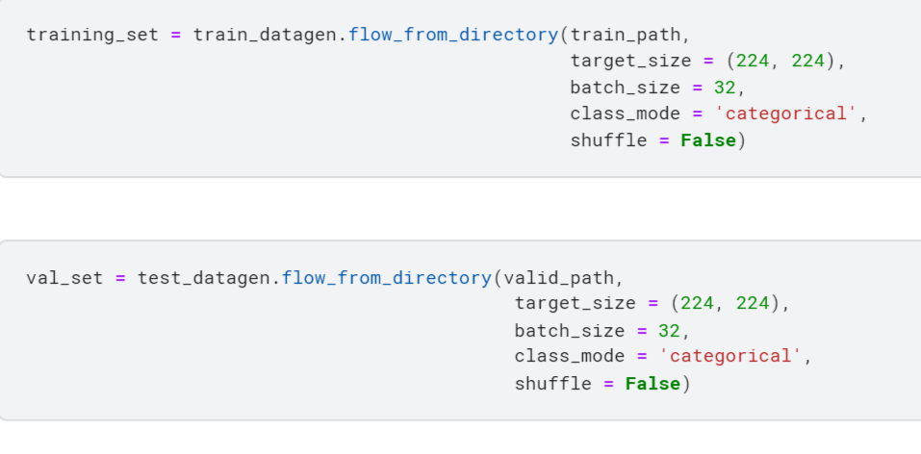

Slide 25
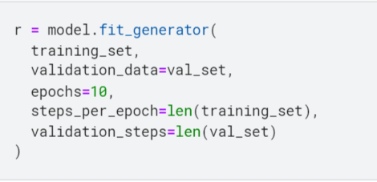

Slide 26
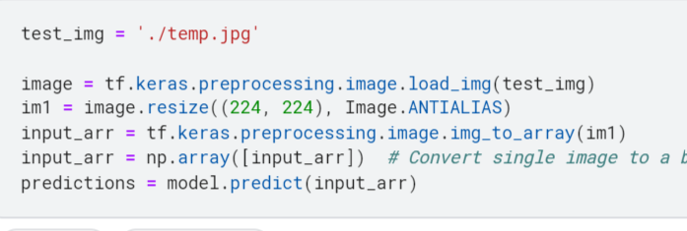

Slide 27
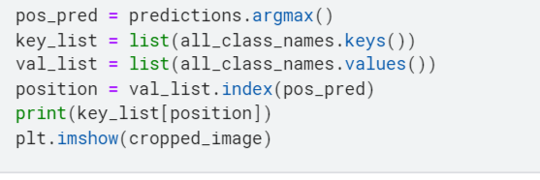

Slide 28
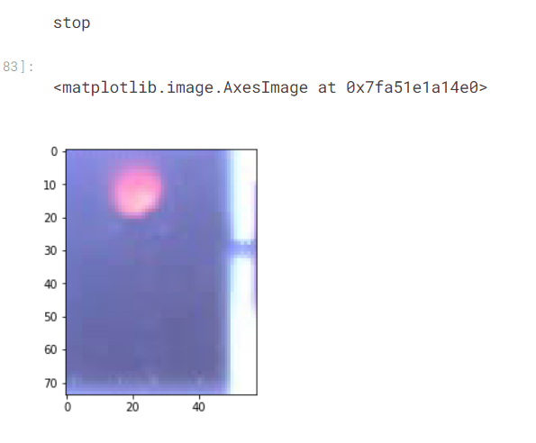
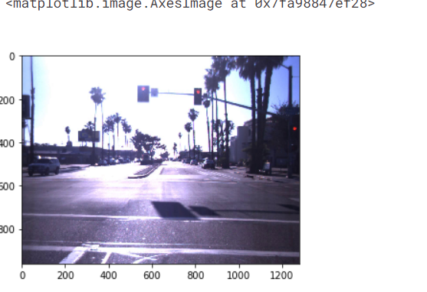

Slide 29
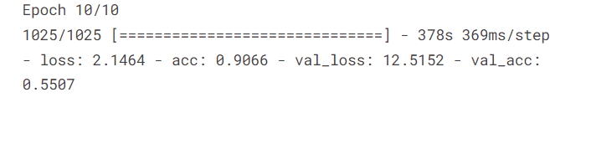

Slide 31
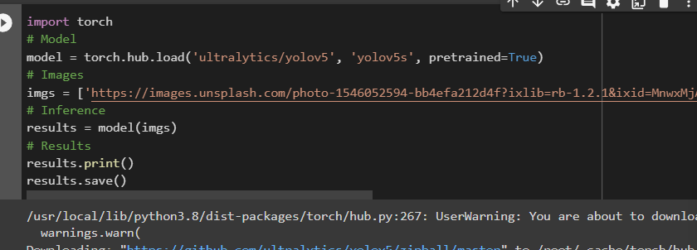
Vehicle And Pedestrian Detection

Slide 32
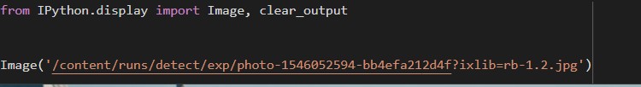

Slide 33
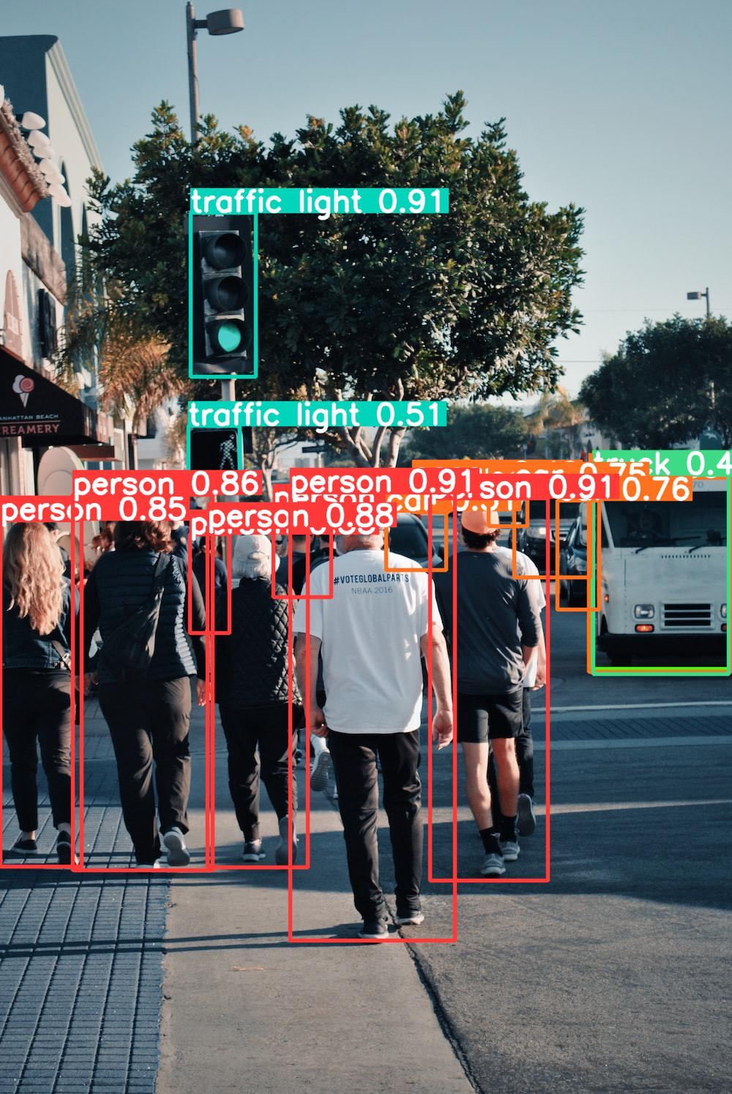

Slide 34
Reference
TensorFlow-
https://www.tensorflow.org/
End to End Learning for Self-Driving Cars -
https://arxiv.org/pdf/1910.11006v2.pdf
End to End Learning for Self-Driving Cars (Paperswith-code) –
https://paperswithcode.com/paper/end-to-end-learning-for-self-driving-cars
Inception V3
https://keras.io/api/applications/inceptionv3/

Slide 35
Future Scope:
Integrating all models
Implementing it in a Physical model

Slide 36
Thank You

